Slide 1

Battle of Neighborhoods
Capstone final project

Slide 2
1. Problem description
The project goal is to use analytical approach to recomend the best location for a Chinese restaurant in London, England. It will be used machine learning techniques, data analyses and, data visualization.

Slide 3
2. Data presentation
The data source is from two sites:
The Foursquare Api: It will be used to obtain the most common venues per neighborhood in London. It will allow the user to know how the city's venues are distributed, what are the most common places for leisure, and in general, it will provide an idea of what people's likes are.
Wikipedia's Ethnic groups in London webpage: This site provides information about ethnicity of population in London. The webpage is scraped using BeautifulSoup4, and the table containing Asian population of London is converted into DataFrame. The data contains information about the inmigrant population per borough and per nationality. This data will be analyzed in such a way that one could determine the best location of r anew venue/restaurant/other based on people's nationalities. For the sake of simplicity, it will be assumed for this exercise that people's likes varies according to their nationality, and that people from one specific country will be more attracted to place that matches the environment and culture of their own countries, rather than the ones from foreign countries.
The data is acessed in the link:https://en.wikipedia.org/wiki/Ethnic_groups_in_London

Slide 4
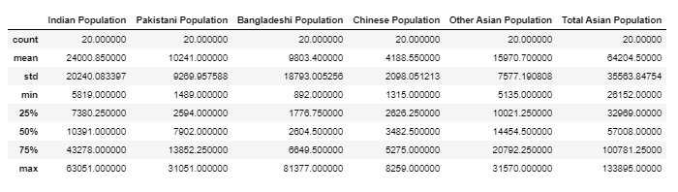
Exploring Asian population in London
As shown above the mean Chinese Population is around 4200 and the maximum population in a neighborhood is 8259.

Slide 5
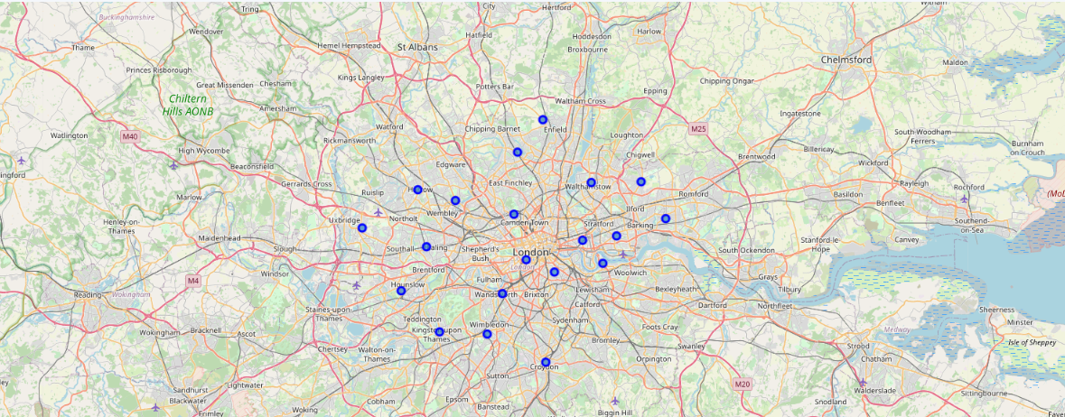
London's map to see the neighborhoods distribution

Slide 6
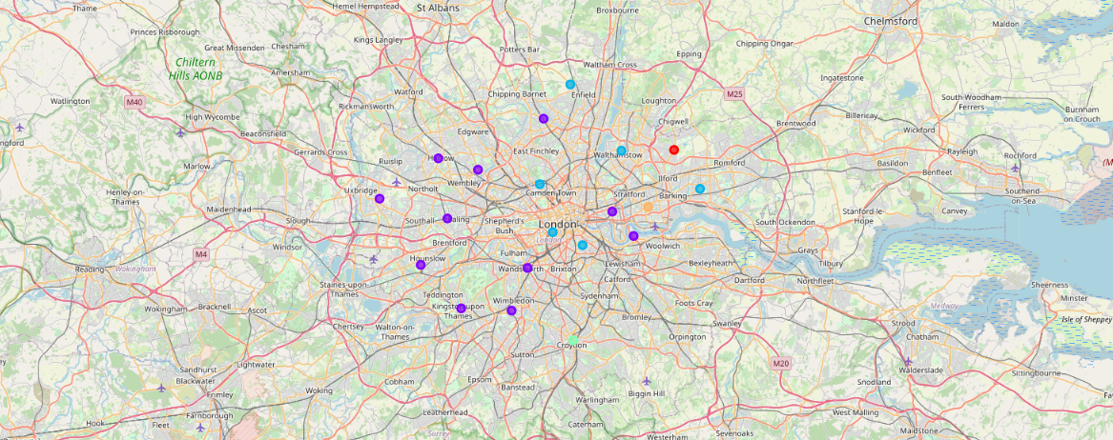
Visualize our Clusters distribution on London's Map

Slide 7
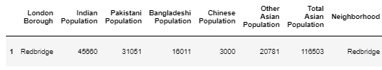
Cluster 1

Slide 8
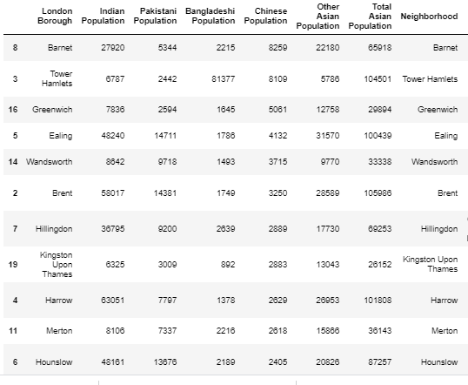
Cluster 2

Slide 9
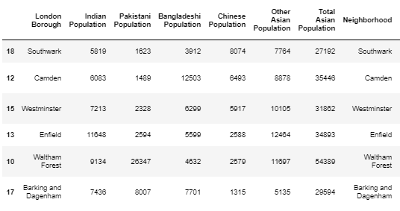
Cluster 3

Slide 10
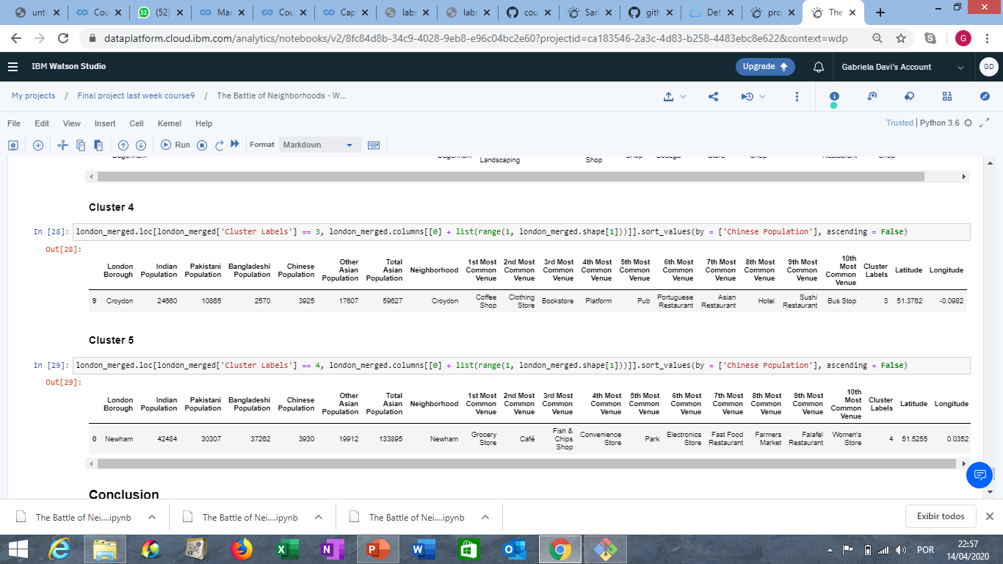
Cluster 4

Slide 11
Cluster 5

Slide 12
Best cluster according with Chinese population
As shown in the previous slides there are more Chinese population in the Cluster 2. The neighborhoods which lead the rank is Barnet and Tower Hamlets.

Slide 13
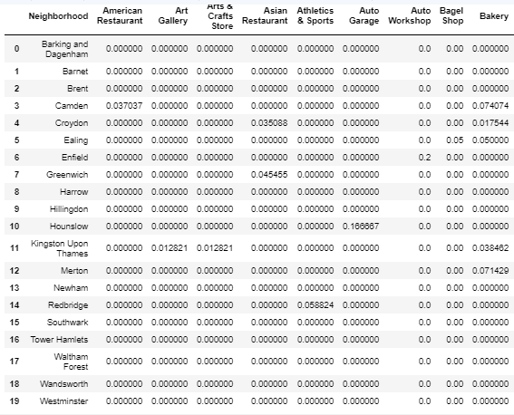
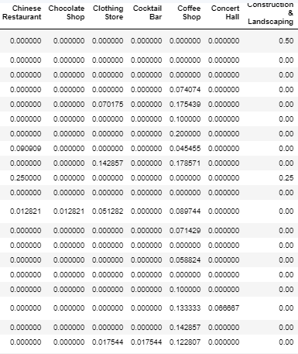
Group by neighborhood and check the mean value of each venue.

Slide 14
As shown in the “Group by neighborhood and check the mean value of each venue” there is no Chinese restaurant in the Neighborhoods with more number of Chinese population.

Slide 15
Conclusion
As we can see, analyzing this dataset, the highest amount of Chinese population is located at Barnet and Tower Hamlets represented in cluster 2. Interestingly, we don't see any Chinese restaurants in the top ten most common venues. Therefore, we have a great business opportunity, in view of the large number of Chinese population living in this region

